Slide 1

Slide 2- <number>

Slide 2
Chapter 2
Database System Concepts and Architecture
Copyright © 2007 Ramez Elmasri and Shamkant B. Navathe

Slide 3
Outline
Data Models and Their Categories
Schemas, Instances, and States
Three-Schema Architecture
Data Independence
DBMS Languages and Interfaces
Database System Utilities and Tools
Classification of DBMSs
History of Data Models
Slide 2- <number>

Slide 4
Data Models
Data Abstraction:
  The suppression of details of data organization and storage and the highlighting of essential features for better understanding
Data Model:
  A set of concepts to describe the structure of a database, and certain constraints that the database should obey.
  Data model helps to achieve data abstraction.
Slide 2- <number>

Slide 5
Categories of Data Models
Conceptual (high-level, semantic) data models:
  Provide concepts that are close to the way many users perceive data.
    Also called entity-based or object-based data models.
Physical (low-level, internal) data models:
  Provide concepts that describe details of how data is stored in the computer.
Representational (Implementation) data models:
  Provide concepts that may be understood by end users but that are not too different from the way data is organized within the computer
  Hide some details of data storage but can be implemented on a computer system in a direct way
  Used by many commercial DBMS implementations (e.g. relational data models used in many commercial systems).
Slide 2- <number>

Slide 6
Schemas versus Instances
Database Schema:
  The description of a database.
  Includes descriptions of the database structure, data types, and the constraints on the database.
Schema Diagram:
  An illustrative display of a database schema.
Schema Construct:
  A component of the schema or an object within the schema, e.g., STUDENT, COURSE.
Database State:
  The actual data stored in a database at a particular moment in time. This includes the collection of all the data in the database.
  Also called database instance (or occurrence or snapshot).
Slide 2- <number>

Slide 7
Database Schema vs. Database State
Database State:
  Refers to the content of a database at a moment in time.
Initial Database State:
  Refers to the database state when it is initially loaded into the system.
Valid State:
  A state that satisfies the structure and constraints of the database.
Schema and State Distinction
  The database schema changes very infrequently. The database state changes every time the database is updated.
  Schema is also called intension whereas State is also called extension.
Slide 2- <number>

Slide 8

Example of a Database Schema
Slide 2- <number>

Slide 9
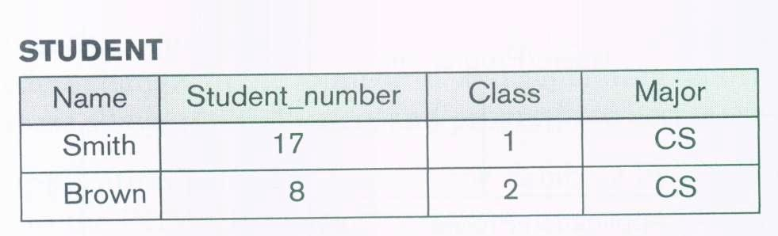
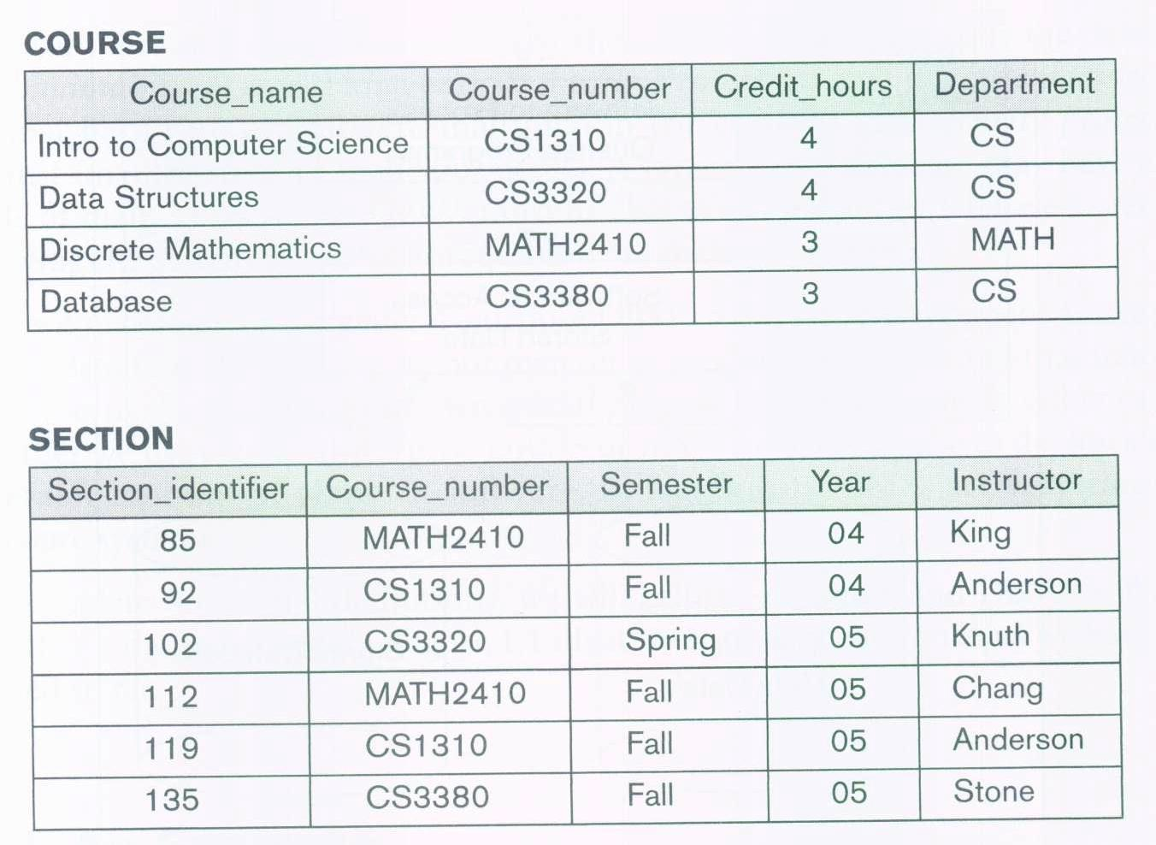
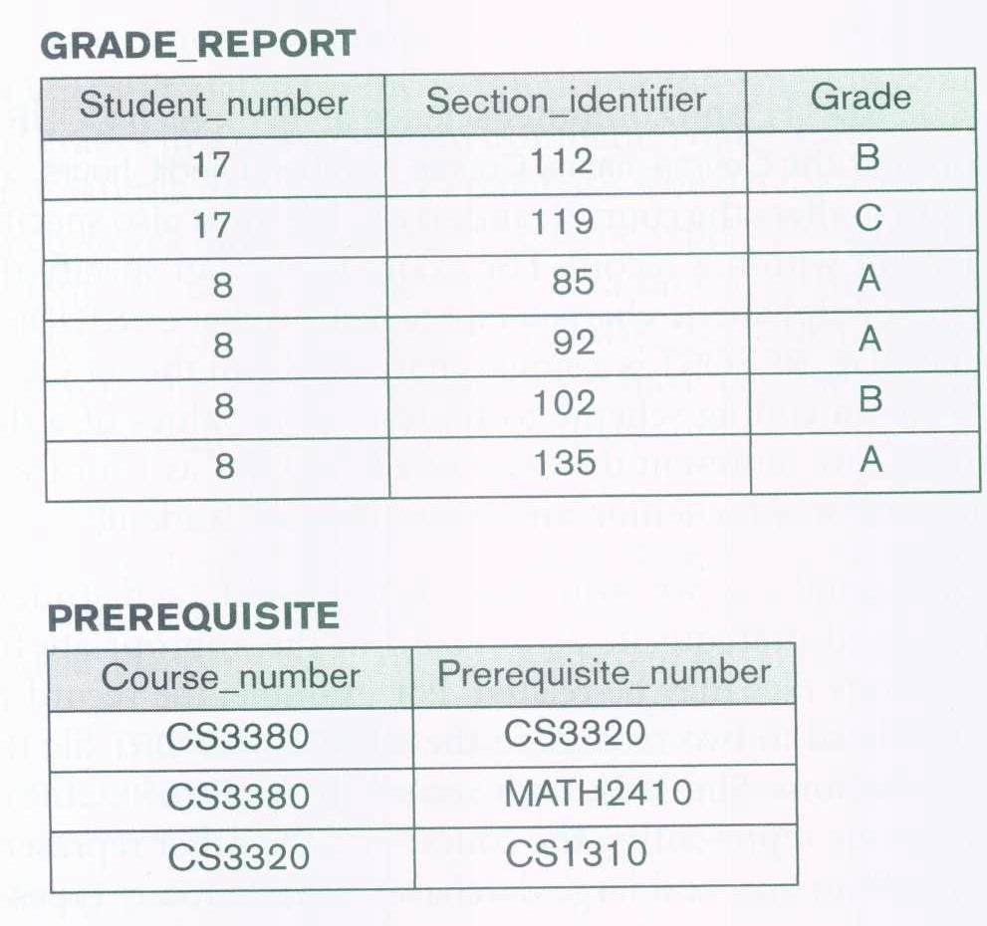
Example of a database state
Slide 2- <number>

Slide 10
Three-Schema Architecture
Proposed to help achieve the DB characteristics
  Specially to separate user applications and the physical database
It defines DBMS schemas at three levels:
  Internal schema at the internal level to describe physical storage structures and access paths (e.g indexes).
    Typically uses a physical data model.
  Conceptual schema at the conceptual level to describe the structure for the whole database for a community of users. It hides the details of the physical storage structures and concentrates on describing entities, data types, relationships, and constraints.
    Uses a conceptual or an implementation data model.
  External schemas at the external level to describes the part of the database that a particular user group is interested in and hides the rest of the database from that user group.
    Usually uses the same data model as the conceptual schema.
Slide 2- <number>

Slide 11

The three-schema architecture
Slide 2- <number>

Slide 12
Data Independence
The ability to change the schema at one level of the database system without having to change the schema at the next higher level.
  Logical Data Independence:
    The capacity to change the conceptual schema without having to change the external schemas and their associated application programs.
  Physical Data Independence:
    The capacity to change the internal schema without having to change the conceptual schema.
Slide 2- <number>

Slide 13
DBMS Languages
Data Definition Language (DDL): a language that is used to define database schemas. The DDL statement is used to identify description of the schema construct and store the schema description in the DBMS catalog.
Data Manipulation Language (DML): a language that is used to manipulate (retrieve, insert, delete, and modify) data.
  A high-level or non-procedural DML can be used on its own to specify complex database operations in a concise manner, such as SQL.
  A low-level or procedural DML typically retrieves individual records or objects from the database and processes each separately, such as PL/SQL.
  Embedded Languages: DML with Java, VB, C++, etc.
Slide 2- <number>

Slide 14
DBMS Interfaces
Stand-alone query language interfaces
  Example: Entering SQL queries at the DBMS interactive SQL interface (such as, SQL*Plus in ORACLE)
Programmer interfaces for embedding DML in programming languages
User-friendly interfaces
  Menu-based, popular for browsing on the web
  Forms-based, designed for naïve users
  Graphics-based
  Natural language: requests in written English
  Parametric interfaces, e.g., bank tellers using function keys.
  Interfaces for the DBA
Slide 2- <number>

Slide 15
DBMS Component Modules
A typical DBMS consists of the following components:
  DDL compiler: process schema definitions, specified in the DDL statements, and stores descriptions of the schemas in the system catalog.
  DML compiler: compiles the DML commands into object code for database access.
  Run-time database processor: handles database access at run time. It receives retrieval and update operations and carries them out on the database.
  Query compiler: handles high-level queries that are entered interactively.
  Data manager: controls access to DBMS information that is stored on disk through interaction with operating system.
Slide 2- <number>

Slide 16

DBMS Component modules
Slide 2- <number>

Slide 17
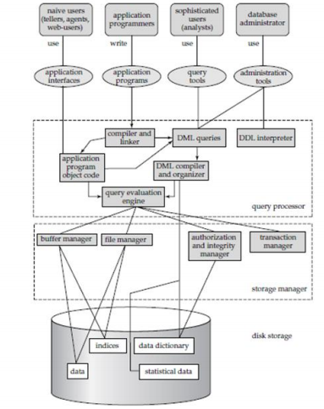
Slide 2- <number>

Slide 18
Database System Utilities
There are some functions that are not provided through the normal DBMS components rather they are provided through additional programs called utilities. Some of these are:
  Loading or import utility: used to load or import existing data files into the database.
  Backup utility: used to create backup copies of the database, usually by dumping the entire database onto tape.
  File reorganization utility: is used to reorganize a database file into a different file organization to improve performance.
  Performance monitoring utility: is used to monitor database usage and provides statistics to the DBA.
Slide 2- <number>

Slide 19
Other Tools
Data dictionary / repository:
  Used to store schema descriptions and other information such as design decisions, application program descriptions, user information, etc.
CASE tools:
  Used in the design phase of database
    Examples: Rational Rose, TOAD
Application Development Environments:
  Provides facilities for developing database applications including database design, graphical user interface development, querying and updating, and application program development.
    PowerBuilder (Sybase), JBuilder (Borland), JDeveloper 10G (Oracle)
Slide 2- <number>

Slide 20
Classification of DBMSs
Several criteria are normally used to classify DBMSs
  Data Model:
    Relational, Object, Object-Relational, Hierarchical, Network
  Number of Users:
    Single-user system
    Multi-user system
  Number of Sites
    Distributed
    Centralized
  Cost:
  Purpose:
    General
    special
Slide 2- <number>

Slide 21
History of Data Models
Network Model:
  The first network DBMS was implemented by Honeywell in 1964-65 (IDS System). Later implemented in a large variety of systems
Hierarchical Data Model:
  Used in IBM’s IMS (and some other products) which still have a large customer base worldwide.
  Dominated the DBMS market during 1965-1985
Relational Model:
  Proposed in 1970 by E.F. Codd (IBM), first commercial system in 1981-82. Currently most dominant.
  In several commercial and free open source products:
    DB2, ORACLE, MS SQL Server, SYBASE, INFORMIX.
    MySQL, PostgreSQL
Slide 2- <number>

Slide 22
History of Data Models
Object-oriented Data Models:
  Comprises models of persistent O-O Programming Languages such as C++ (e.g., in OBJECTSTORE), Java and Smalltalk (e.g., in GEMSTONE).
Object-Relational Models:
  Most Recent Trend. Started with Informix Universal Server.
  Relational systems incorporate concepts from object databases leading to object-relational.
  Exemplified in the latest versions of Oracle-10i, DB2, and SQL Server and other DBMSs.
Slide 2- <number>

